Slide 1
Rural Tourism for Women’s Empowerment
Dr.Palitha Gurusinghe
President
Sri Lanka Ecotourism Foundation Consultant
South Asia Women’s Network (SWAN), Sri Lanka Chapter

Slide 2
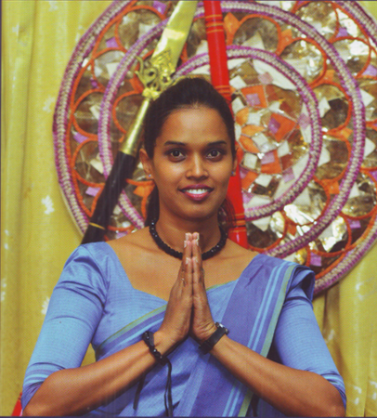
Ayubowan from Sri Lanka!
May You Be Blessed With Long Life….
The Sri Lankan traditional gesture of welcome with fingers of both hands touching each other and both palms clasped together the age old greeting of us Sri Lankans!

Slide 3
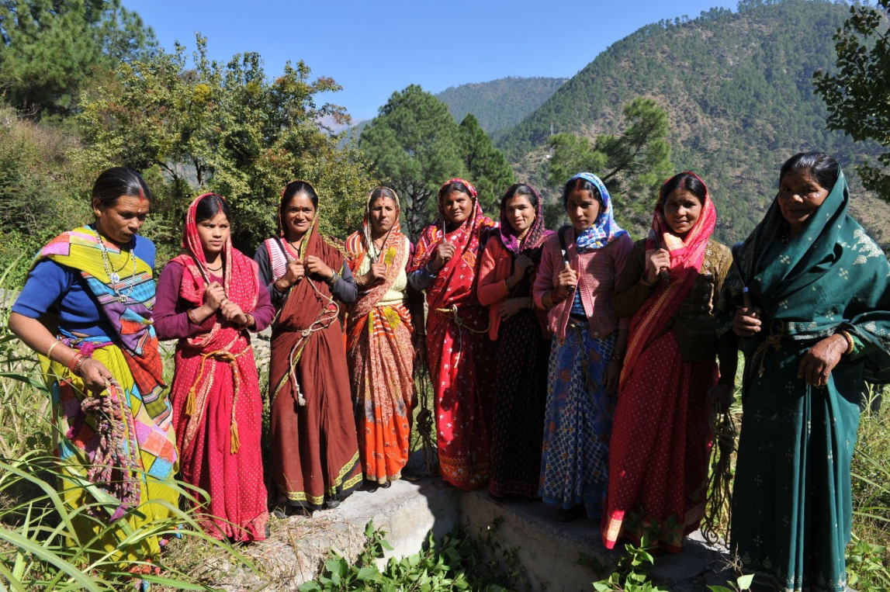
Greetings from Sri Lanka Ecotourism Foundation, the pioneer National Ecotourism Society of Sri Lanka
www.srilankaecotourism.org

Slide 4
Theme: Rural Tourism for Women’s Development
This theme Is one of the core objectives of the SWAN’s Road map. The South Asia Women’s Network (SAWN) brings together women leaders from nine South Asian countries: Afghanistan, Bangladesh, Bhutan, India, Myanmar, Maldives, Nepal, Pakistan, and Sri Lanka. SWAN’s Vision on Rural Tourism for Women's’ Empowerment as spelt out at its Fifth Annual Conference in Colombo in August 2013, is to bring in sustainable development for South Asia, where women play equal and equitable roles in the socio-political and economic.

Slide 5
SWAN has been focusing on this theme for many years, working hard to realize the core objectives through landmark forums, conferences, workshops etc. held in South Asian Region.
Let me list out some of the forums that SWAN conducted in this regard.
Fifth Annual Conference in Colombo, in August 2013
The Workshop in Thimphu, Bhutan, on Ecotourism for Sustainable Development and Gender Empowerment in South Asia in September 2014.
AGM of SWAN in Myanmar in 2015
SWAN Kathmandu Conferences in 2017
SWAN Inception Workshops, field trips in New Delhi and Uttarakhand in 2019.
Today, in May, 2024 in Nepal
For us in Sri Lanka, we were fortunate to initiate a project on Social and Economic Empowerment for women in the famous South Coast Beach Holiday Resort in Hikkaduwa, Sri Lanka. It is one of the Flagship Projects initiated by Sri Lanka Ecotourism Foundation in collaboration with SWAN based on the guidelines set up at the Workshop held in Thimphu, Bhutan, on “Ecotourism for Sustainable Development and Gender Empowerment in South Asia in September 2014”

Slide 7
The Main Objectives of the Hikkaduwa Ecotourism Project in Sri Lanka
Strengthen of Institutional Capacity of Women through Ecotourism Development
Open up avenues to ensure Income Generating Activities (IGE) for women
Open up new ecotourism products for the tourism industry at national level
Develop socioeconomic and socio-cultural benefits to the rural communities in tourism generating areas of Sri Lanka
Develop strategies to empower women, including through livelihood opportunities, in sustainable ecotourism in the SAWN member countries. These strategies would cover the areas of policy recommendations and advocacy (to Governments), including for Sustainable Development Goals (SDGs) in the sector of eco-tourism, as well as leadership development among women, and capacity-building for change at all levels

Slide 8
Anticipated Stakeholder Benefits
Assure Economic and Social benefits to the community
Develop welfare programmes and facilities to the communities through the proposed project
Conservation of biodiversity of the areas where the project is to be located

Slide 9
Income Generating Activities (IGA) Proposed
Suggested activities which could be performed for the tourists through the Community based Agritourism Project
MANAGING OF HOMESTAY/ ECOLODGES
COMMUNITY CAMPING
AGROTOURISM/AGRICULTURE AND ORGANIC FARMING PLOTS
AYURVEDA AND SPIRITUAL TOURISM/INDIGENOUS MEDICAL PRACTICES
GUIDING AND INTERPRETATION
OPEN-FIRE COOKING DEMONSTRATIONS
MAKING HANDICRAFT ITEMS
STUDY OF TRADITIONAL AGRICULTURAL PRACTICES/ HYDRAULIC CIVILIZATION OF SRI LANKA
BIRD WATCHING
WILDLIFE WATCHING
FISHING/ANGLING
TREKKING AND HIKING
CYCLING
CANOEING AND KAYAKING
CONDUCT HERITAGE CULTURAL/NATURE TOURISM PROGRAMMES
TRADITIONAL LIFESTYLES AND GAMES
BOATING (USING NON-MOTORIZED WATER CRAFTS)
PRODUCTION OF DEHYDRATED FOODS AND HERBAL POWDER
PROMOTING VOLUNTOURISM

Slide 10
Community Tourism Training Modules
Communication skills
Customer handling
Interpersonal skills
Innovative skills
Eco-friendly practices
Solid Waste management
Micro –finance management
Knowledge on appreciation of biodiversity and the environment
Organizing skills
Public Relation skills
Leadership qualities
Decision making under pressure
New product development
Coordination skills
Finance handling
Marketing/sales skills

Slide 11
Facilitate in manufacture of dehydrated foods and Herbal Products in association with LT Eco Food Products, a Member of B500 Projects sponsored by the National Enterprise Development Authority (NEDA), Ministry of Industries, Sri Lanka.
Website; www.ltecofoods.com

Slide 12
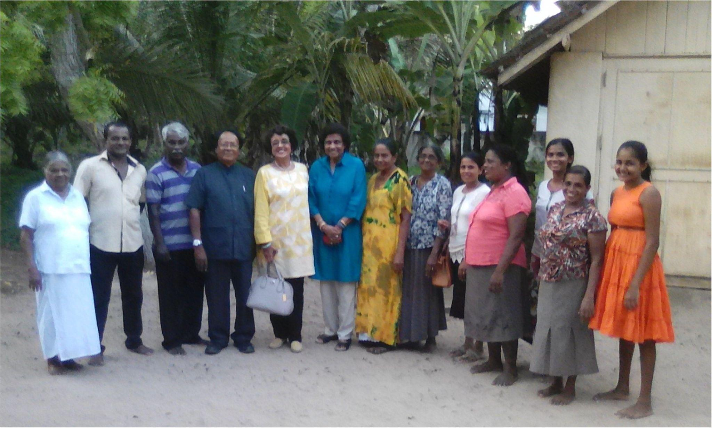
Going Down Memory Lane
Professor Veena Sikri
Visiting Hikkaduwa Ecotourism Project 2019

Slide 13
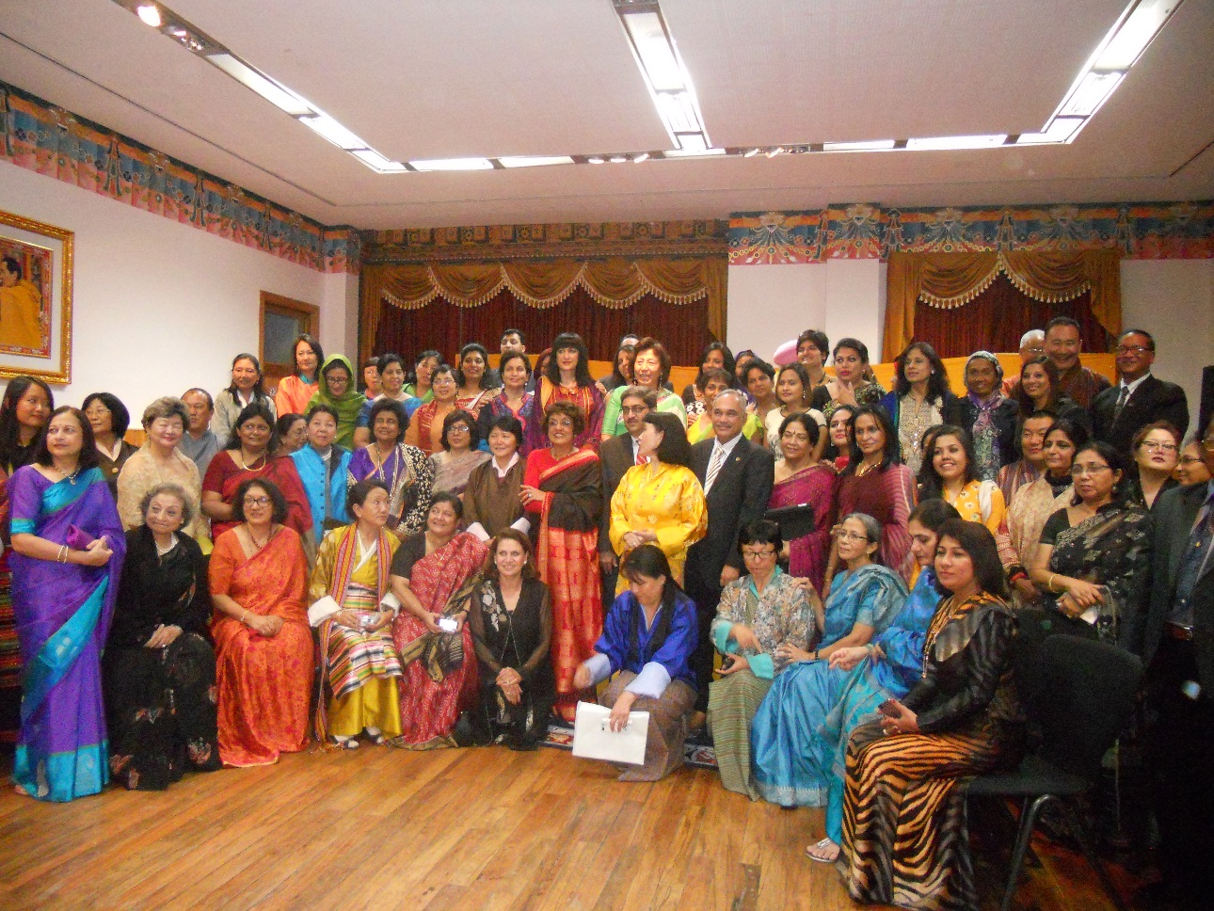
BHUTAN 2014

Slide 14
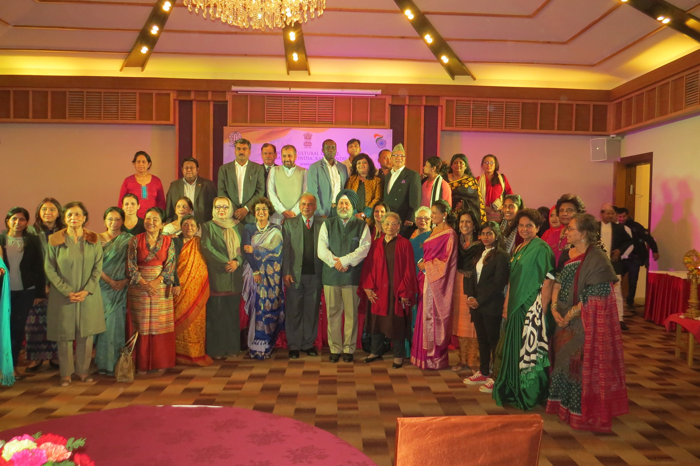
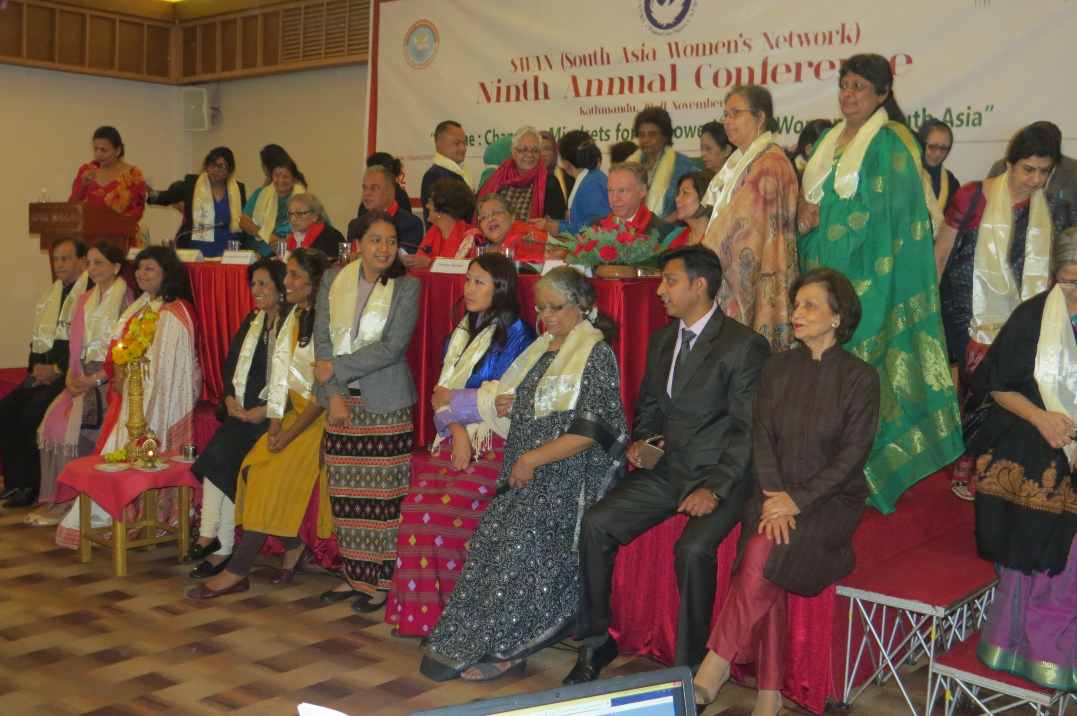
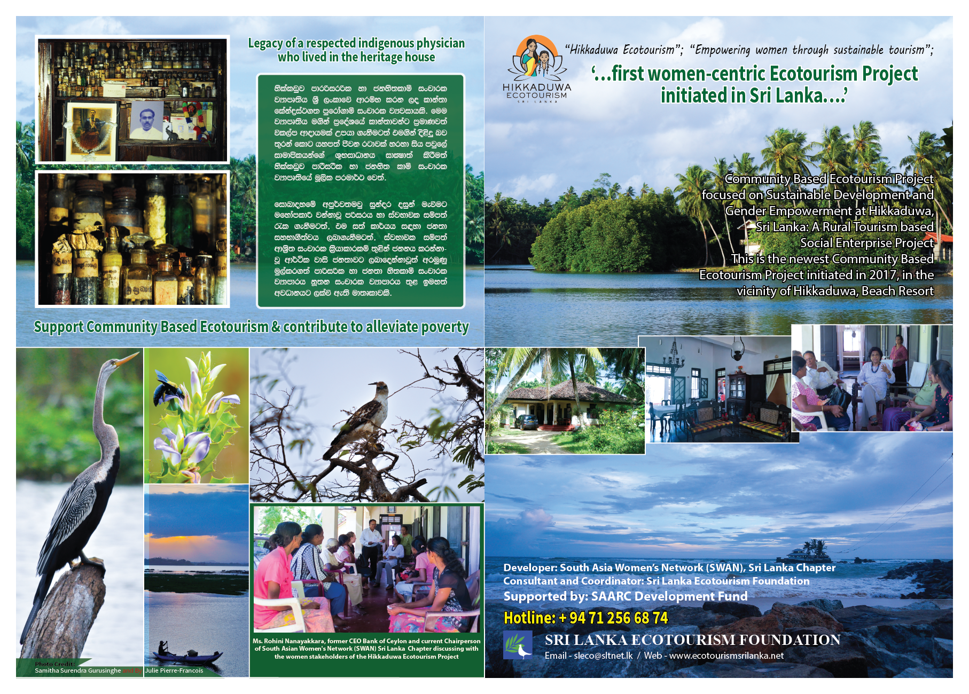
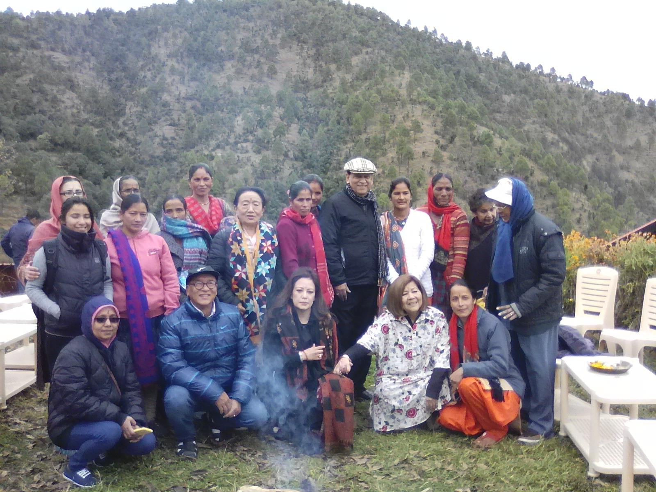
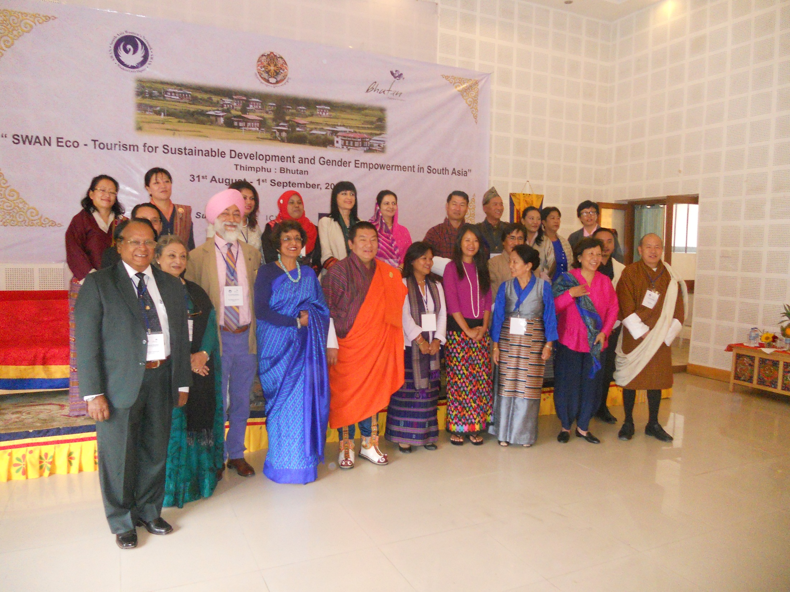
KATHMANDU, NEPAL 2017

Slide 15
BHUTAN 2014

Slide 16
UTTARAKHAND, INDIA 2019

Slide 17
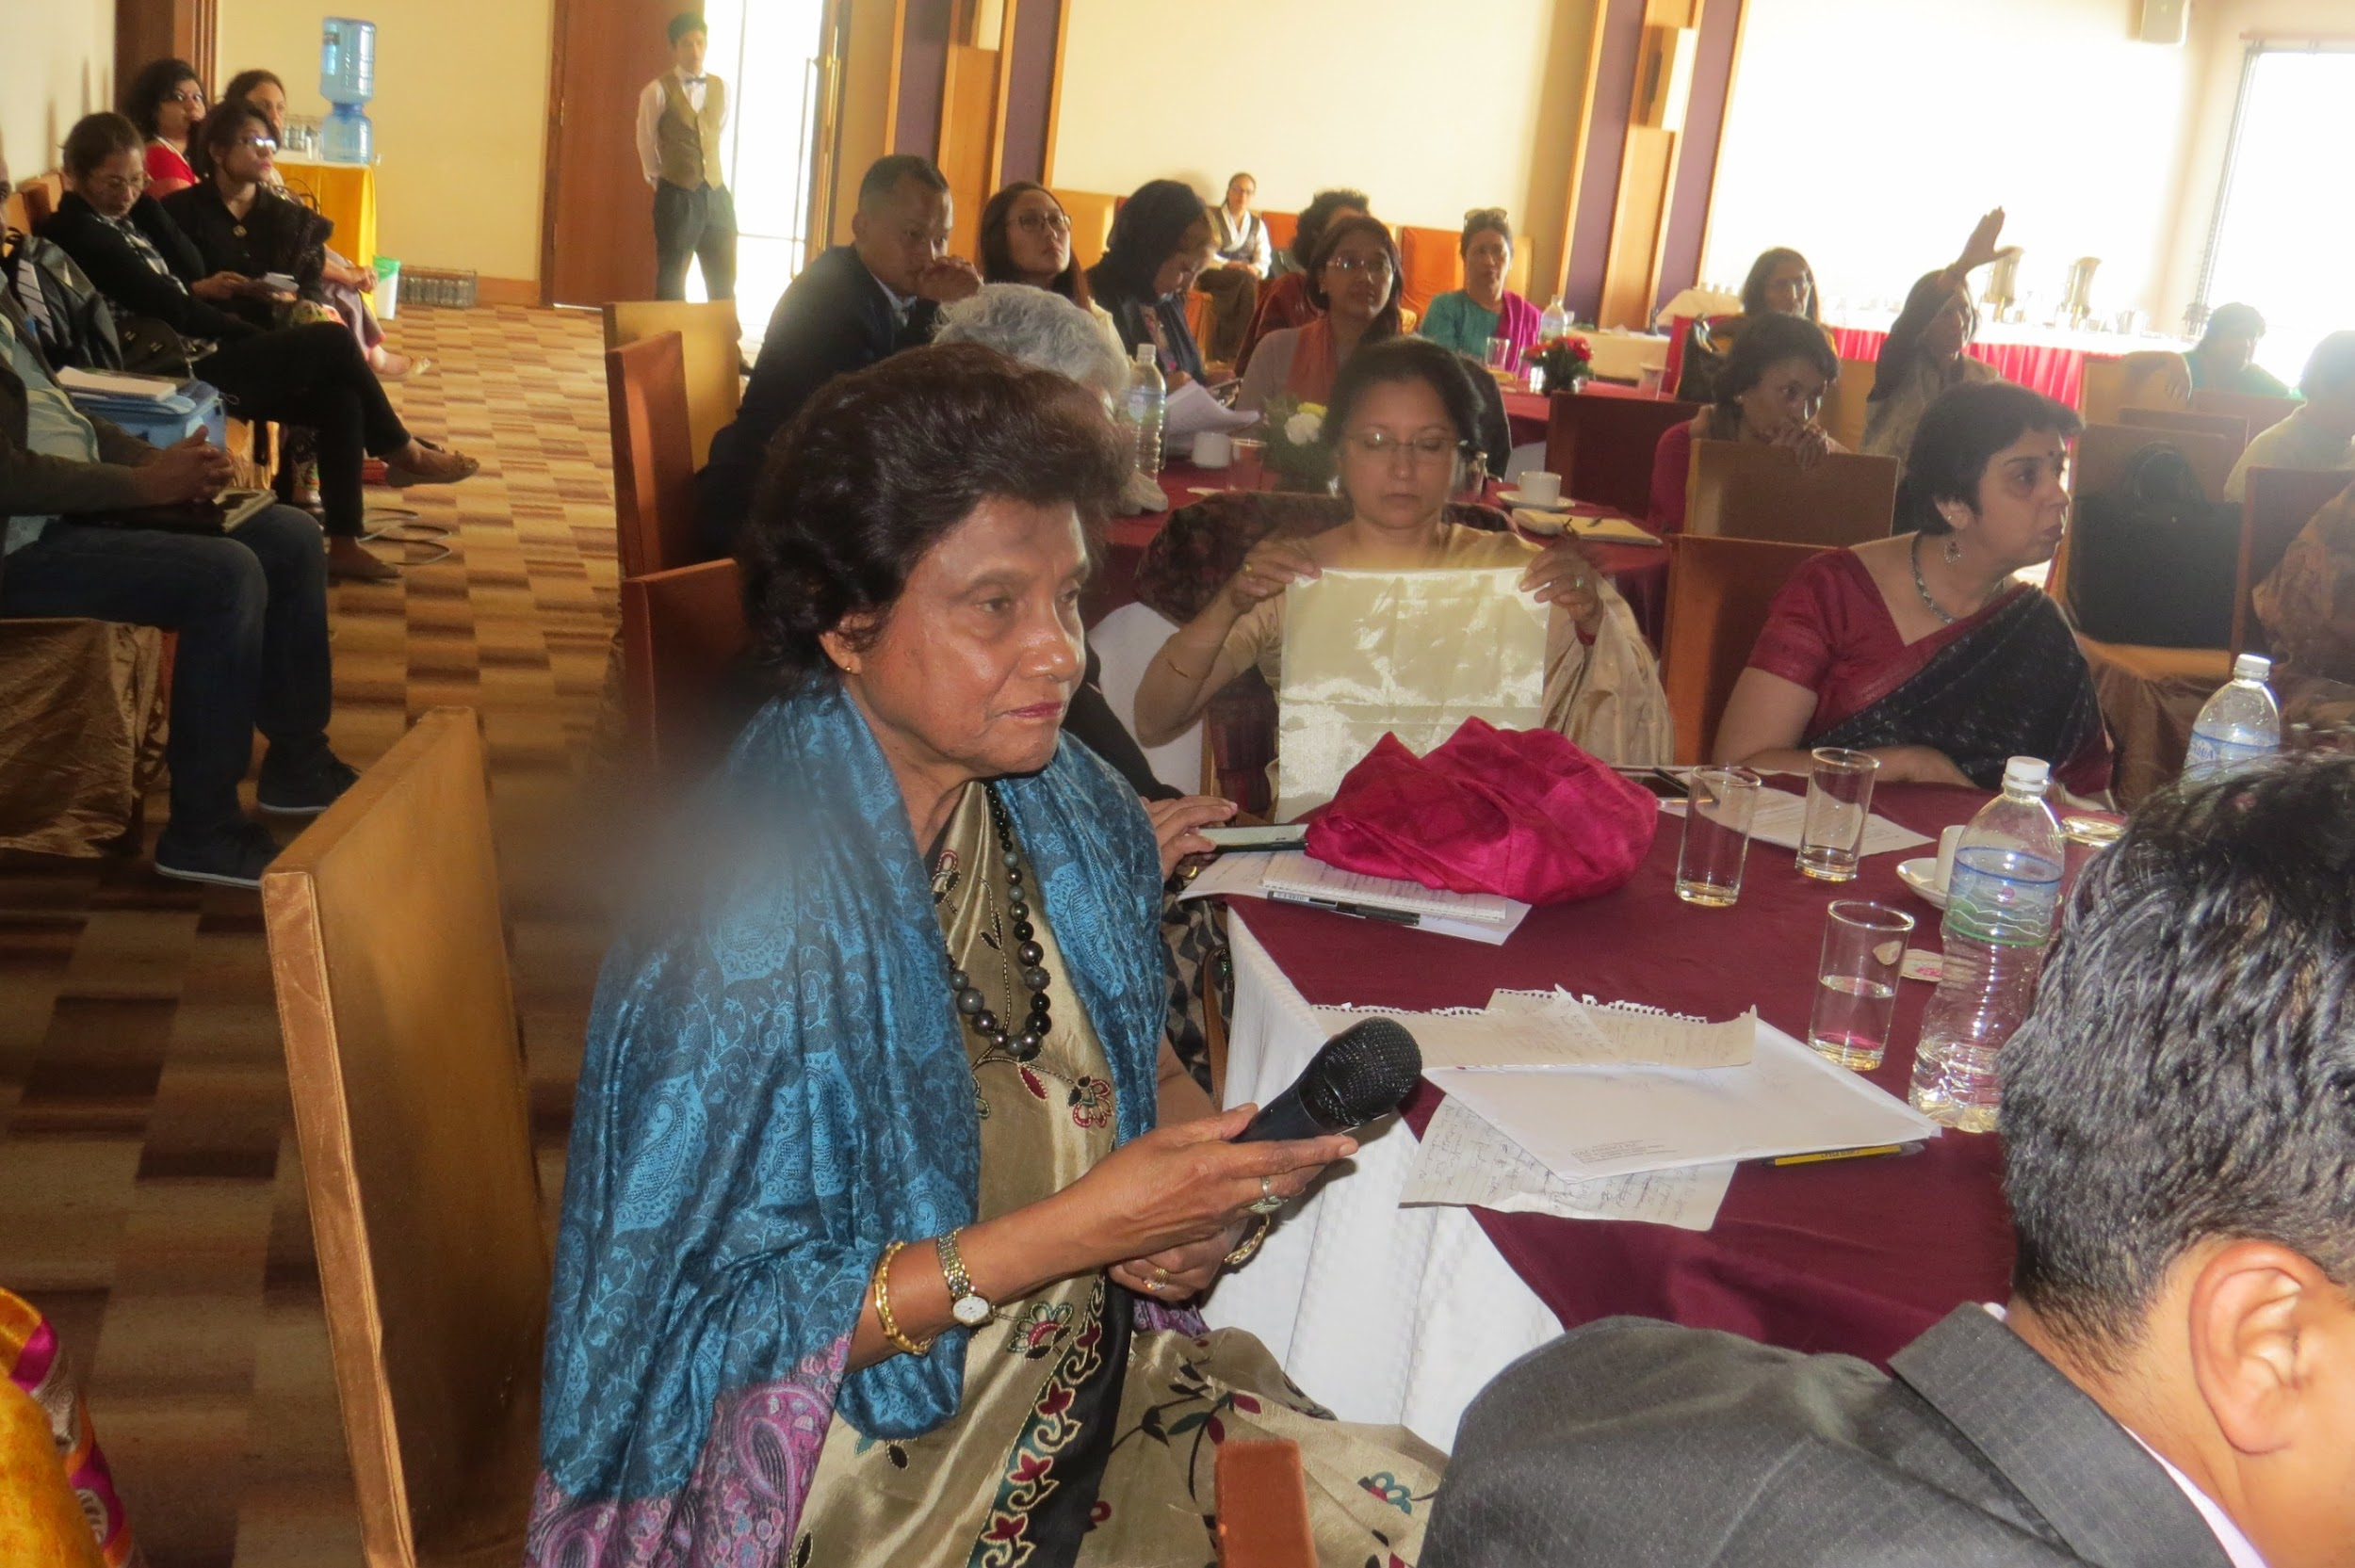

Slide 19
THANK YOU!
Dr.Palitha Gurusinghe
President
Sri Lanka Ecotourism Foundation Consultant
South Asia Women’s Network (SWAN), Sri Lanka Chapter

